Slide 1




AT82.02
Data Modeling and Management
Unit 6-1: Choosing the right Database technology
Chutiporn Anutariya (chuti at ait dot ac dot th)

Slide 2
Relational DBs are the most successful technology for the last 50 years

Slide 3
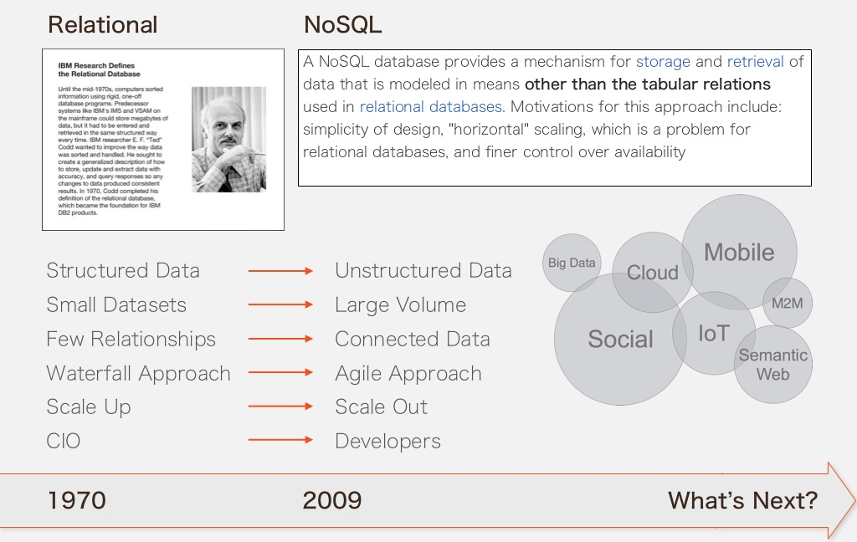
[src: https://www.slideshare.net/lvca/polyglot-persistence-vs-multimodel-databases]

Slide 4
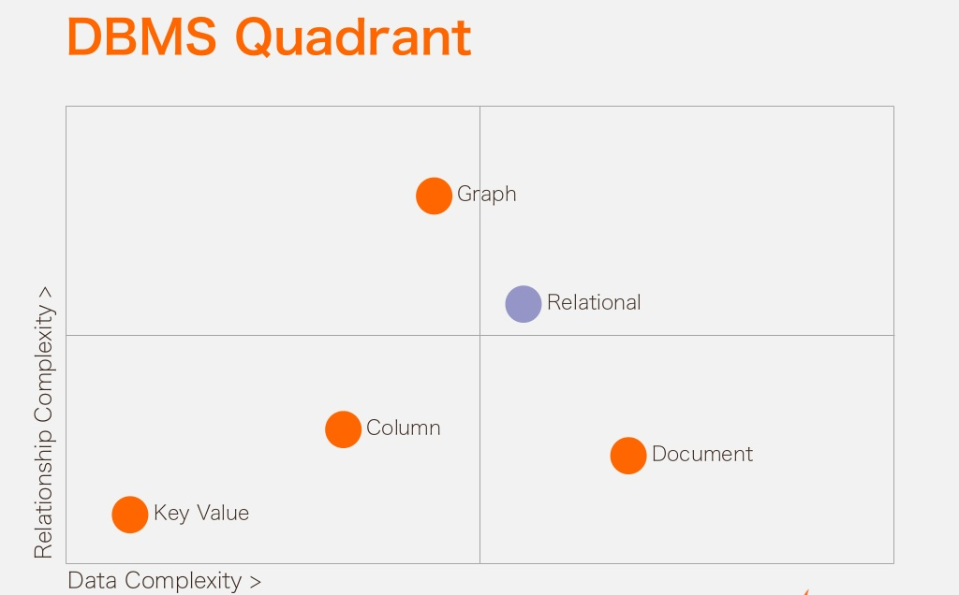
[src: https://www.slideshare.net/lvca/polyglot-persistence-vs-multimodel-databases]

Slide 5
One size fits all DB may not exist!

Slide 6
Polyglot Persistence
When storing data, it is best to use multiple data storage technologies, chosen based upon the way data is being used by individual applications or components of a single application.
Different kinds of data are best dealt with different data stores.
In short, it means picking the right tool for the right use case.

Slide 7
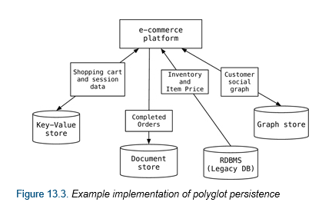
Polyglot Persistence example
An e-commerce platform will deal with many types of data (i.e. shopping cart, inventory, completed orders, etc) using a mixture of RDBMS solutions with NoSQL solutions
[src: https://www.jamesserra.com/archive/2015/07/what-is-polyglot-persistence/]

Slide 8
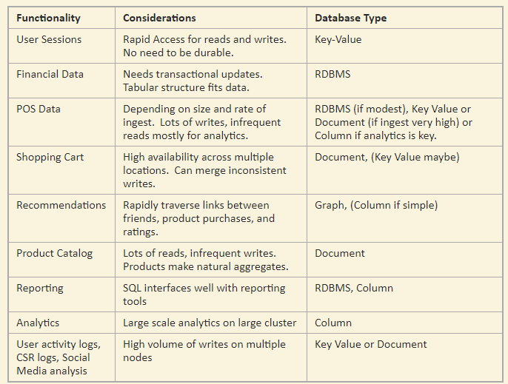
Different Data Stores are suitable with different requirements and usecases
[Src: https://www.jamesserra.com/archive/2015/07/what-is-polyglot-persistence/]

Slide 9
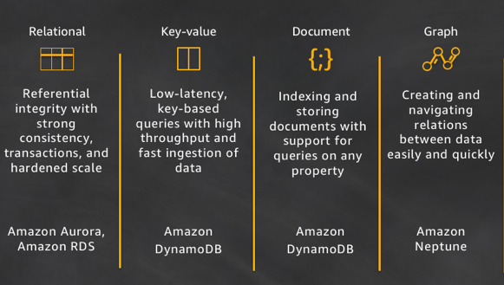
Multiple AWS services
[src: https://www.allthingsdistributed.com/2018/06/purpose-built-databases-in-aws.html]

Slide 10
Summary
Databases are built for a purpose and matching the use case with the database will enable developers to write high-performance, scalable, and more functional applications faster.
Developers also are no longer using a single database for all use cases in an application—they are using many databases.

Slide 11

P. Sadalage and M. Fowler: NoSQL Distilled: A Brief Guide to the Emerging World of Polyglot Persistence, Addison-Wesley Professional, 2013
D. Sullivan: NoSQL for Mere Mortals: Software Independent Approach, Addison-Wesley Professional, 2015

Slide 12

Thank you.
Let’s Summarize!

